Slide 1
ENTERPRISE WEB SOFTWARE DEVELOPMENT

Slide 2
Product Review
In the section, I will show you the detailed and realistic images of the system that we have built and give specific examples of the functions of each user.
Functional Requirement
A system needs functions to meet the needs of the user. A must-have function for a system is the login function. This function is necessary because it protects the user's personal information as well as protects the data for the system. With the system we are building, we want to make it convenient for users, as they do not need to waste time on account registration. They can use google account to login to the system. In this section we will analyze why we use authentication by google API explicitly.

Slide 3
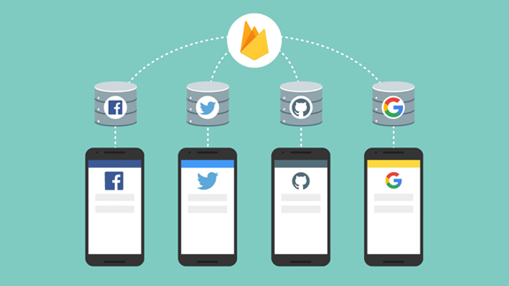
Functional Requirement
Authentication by Google API
The system we are building needs to know the identity of the user. This allows the system to store user data in the database. With a specific identity the system will fetch specific data for each user and display it.

Slide 4
Functional Requirement
With the firebase platform that the system is using, firebase authentication provides ancillary services, easy-to-use SDKs and ready-made UI libraries. This helps authenticate users to the system, and our most popular link choice is Google.
By using Firebase SDK authentication, login method will be added to the system. Authenticate users by integrating a google link identification provider, and allow users to log in with a Google account.
Firebase Authentication on Websites
Users use Google accounts to log in to the system. To do this, need to integrate Google Login using the Firebase SDK. Firstly, I activated Google login in Firebase control panel.

Slide 5
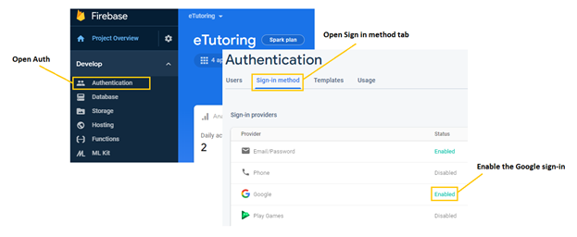
Functional Requirement
The next step is to handle the login flow to handle I have used JavaScript in the following way. In the first lines of code create a version of the Google provider object, followed by the second line of code validating using the Google provider object a popup window for users to log in with a Google Account there.

Slide 6
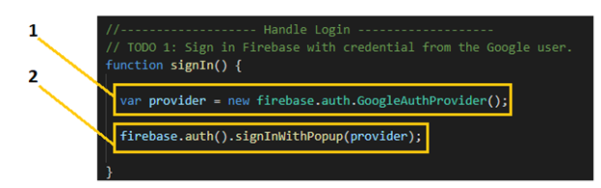
Functional Requirement
The next step is to handle the login flow to handle I have used JavaScript in the following way. In the first lines of code create a version of the Google provider object, followed by the second line of code validating using the Google provider object a popup window for users to log in with a Google Account there.

Slide 7
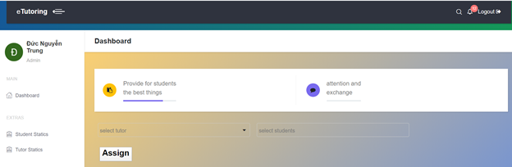
Product Review
Admin Interface
After the admin has successfully logged in, they can choose students and assign them to any tutor. We have designed the website so a tutor can have many students. Once the assignment is complete, the admin can scroll down to see if there are no students assigned to the tutor yet. In the table will also show the tutor is not enough students so admin can choose to assign students to them.

Slide 8
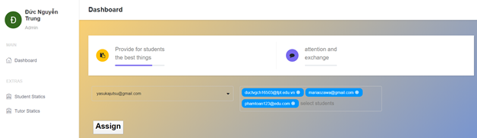
Admin Interface
As you can see, the admin can choose one tutor and assign multiple students to the tutor at the same time as long as the number does not exceed the allowed limit.

Slide 9
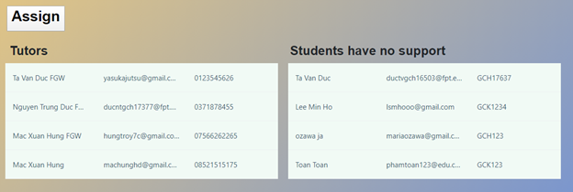
Admin Interface
After finishing the assignment, when the admin scrolls down, you will see a list of students who have not been assigned a tutor.

Slide 10
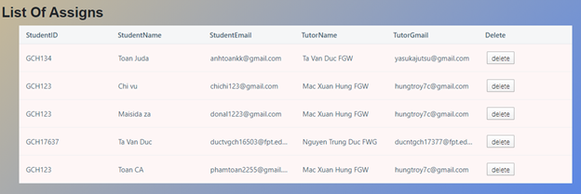
Admin Interface
As shown above when designing wireframes, administrators will be able to see the information of assigned students and their tutors. When the admin clicks on the "Delete" button, The student will be delete of the table.

Slide 11
Tutor Interface
As a Tutor, you will have functions that include creating meetings with students, creating posts, communicating with students.
The first is the meeting, the image below is the interface of meeting activities, it is located on the right of webpage. The list of created meetings will appear below, once the meeting has been confirmed by the student, the plane paper icon will change to like icon. Tutor can also delete the meeting by clicking the X mark. In the upper right corner, plus icon is used to create meeting.

Slide 12
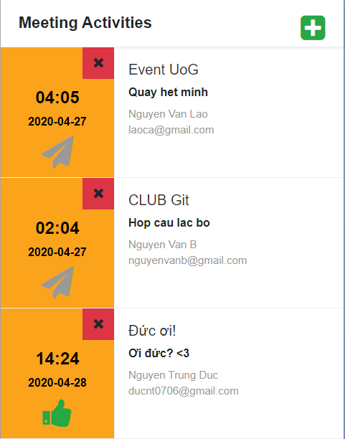
Tutor Interface

Slide 13
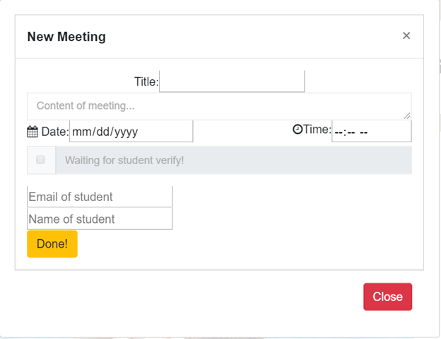
Tutor Interface
After click on it, a creating meeting popup will be show. A meeting consists of 6 information: title, content of meeting, date, time, email and name of student. The meeting will be created after the tutor clicks “Done!” Button. If tutor want to stop creating the meeting, the tutor can click the “Close” button or the X mark in the upper right corner.

Slide 14
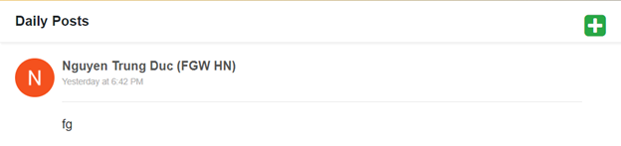
Tutor Interface
The next is Post, it is located on the middle of webpage. Similar to meeting, to create a new post, tutor must click on plus icon in the upper right corner. Tutor can also delete the post when click on Delete button. Tutor can view other tutor’s posts but they can’t delete it.

Slide 15
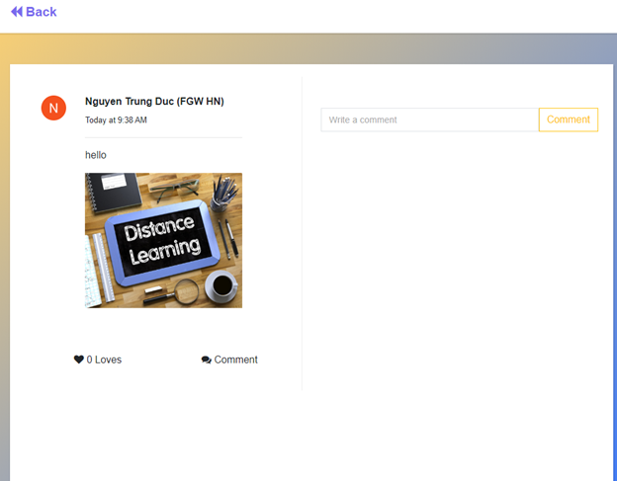
Tutor Interface

Slide 16
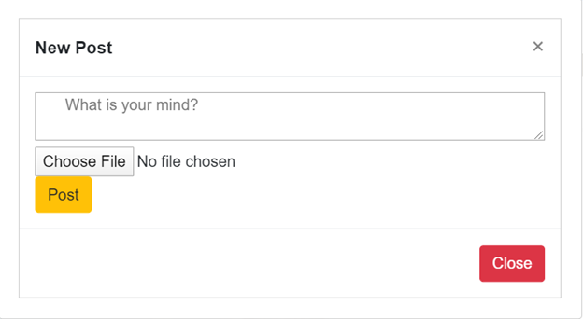
Tutor Interface
In creating post popup, tutor can write content, upload image and post the post. If tutor want to stop creating the post, tutor can click the Close button or the X mark in the upper right corner.

Slide 17
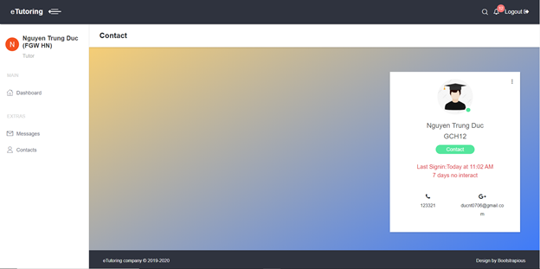
Tutor Interface
Contacts task is located on the menu bar. In contacts task, information of this tutor’s students will be showed in there including name, student code, mobile phone, email and last interaction. Moreover, tutor can chat with student by clicking the Contact button in the middle of information table or choose Messages task.

Slide 18
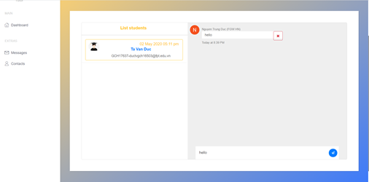
Tutor Interface
This is the interface of Messages task it consists list of student and messages box. Tutor can send message to their students. In the messages box, tutor can delete their sent message by clicking the X mark in the right of this message.

Slide 19
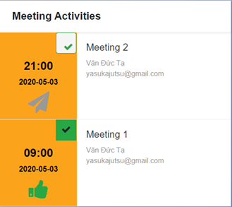
Student Interface
As a student, you will also have functions that relate to meeting, post and contact but it has some difference with tutor. The interface of student website is similar tutor’s interface. The first is the meeting, students can’t add and delete meeting but can confirm the meeting. To confirm meeting, student need click on red check icon, after meeting is confirmed, the plane paper icon will change to like icon.

Slide 20
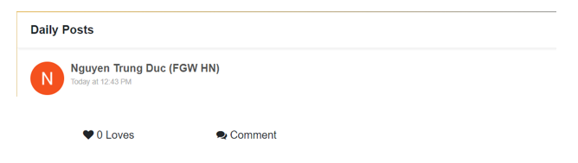
Student Interface
The next is Post, students have less functions than tutor, they can only love and comment their tutor’s post. It’s mean they don’t have creating and deleting meeting.

Slide 21
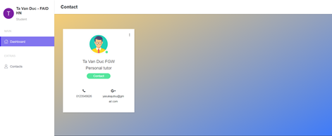
Student Interface
In contacts task, information of this student’s tutor will be showed in there including name, mobile phone, email and position. Moreover, student can chat with their tutor by clicking the Contact button in the middle of information table.

Slide 22
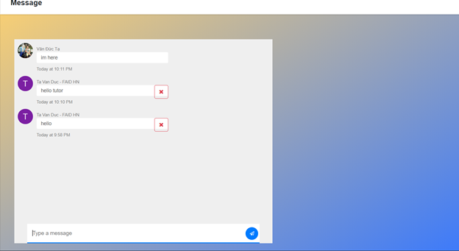
Student Interface
This is the interface of Messages task it consists only the messages box because student has one tutor. Therefore, student can only send message to their tutor. In the messages box, student can delete their sent message by clicking the X mark in the right of this message like tutor.

Slide 23
Non-Functional Requirements
Security
Firebase Realtime Database Rules
Firebase Realtime Database Rules help determine who will read and write access to the system database. This job will be executed automatically continuously, all requests (read, write) will only be done when rules allow. This protects the system database from hackers and from being abused. By default, the system's database rules require Firebase Authentication and only grants full read and write permissions to the authenticated user.
Information includes their unique identifier (UID) as well as associated account data (Figure 4). Will be stored in the auth variable when the user authenticates. By combining Firebase Realtime Database Rules language with authentication information users the system can be able to control access to data based on user identity.

Slide 24
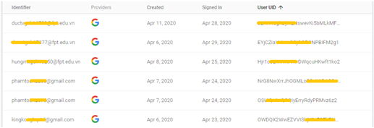
Firebase Realtime Database Rules

Slide 25
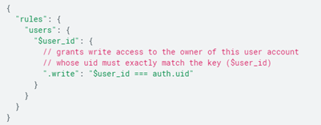
Firebase Realtime Database Rules
This is an example of how we use the auth variable to ensure that each user can only write to their specific path and cannot write to other users' data.

Slide 26
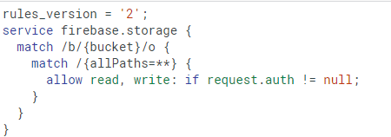
Firebase Security Rules for Cloud Storage
Similar to Database Rules, security is one of the most complex parts of system development. Authentication (who the user is) and authorization (what the user can do) are hard work. To make it easier, I used Firebase Security Rules for Cloud Storage, which made it easier for me to authorize users and validate requests. With this rule it will help me complete the complex processing.
For the example shown in Figure 6, this system always requires the default Firebase Authentication to perform any read or write operation on all files.

